Slide 1
IITBX
MOOC
Project Team
Abhinav Puri
Abhilash Kadhane
Anushree Jangid
Divya Pitta
Dhruva Bhaswar
Kushal Yarlagadda
Mundru Mahendra
Roshan Piyush

Slide 2
Project Scope
Designed around the key principles of openness, diversity, interactivity and autonomy.
Quality education free of cost.
Access to world-class faculty and an unconventional curriculum.
Can bring about a drastic change in the conventional education system.

Slide 3
edX
A massive open online course platform founded by MIT and Harvard University
Offers online university-level courses in a wide range of disciplines to a worldwide audience free of cost.

Slide 4
IITBX
A Massive Open Online Course (MOOC) built based on the edX-platform that went open source on June 1st 2013.

Slide 5
Basic Control Flow
CMS
Handle accounts and logins. Create new course - Add lecture videos and quizzes.
LMS
Search for the published course
Register for the published course
Course
Complete the course
Publish course
Take part in discussion forums

Slide 6
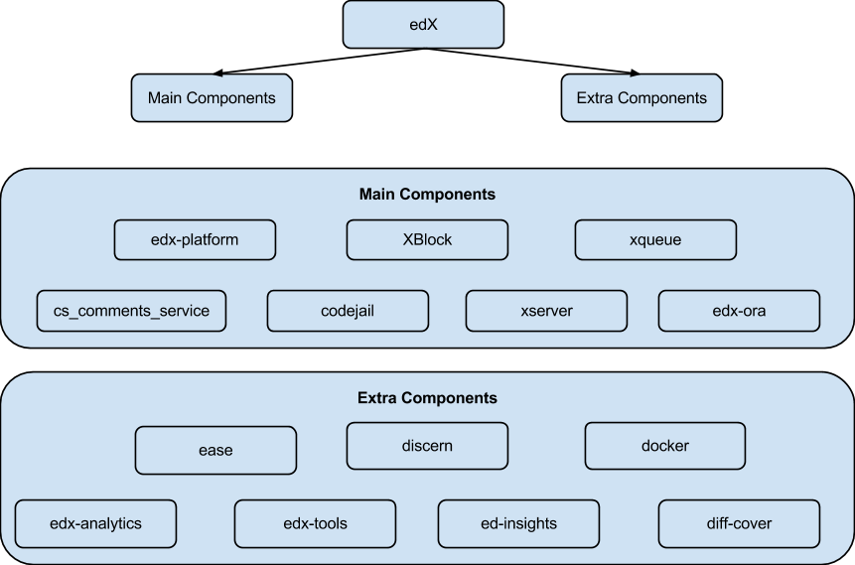
edX Modules

Slide 7
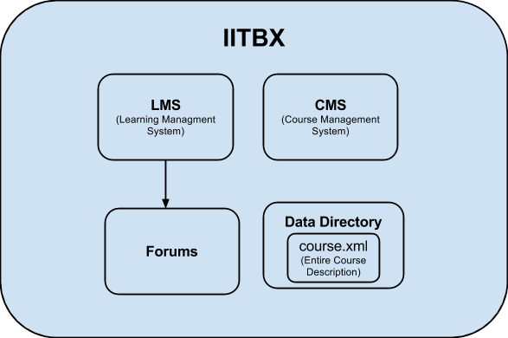
IITBX <--> edX
Consists of LMS and Studio(CMS)
Uses django framework (python) and rake (software task management tool written in ruby) for installation.

Slide 8
LMS
LMS – Learning Management System
Student-side part of the platform
It handles :
Student accounts
Lecture videos
Quizzes
Exercises
Assignments, etc.

Slide 9
CMS
CMS – Content Management System
Instructor-side part of the platform
It allows :
Instructors to create and modify their course.
Add lecture videos and content materials.
Update and add quizzes and assignments.
Update deadlines and reorder the course as per the instructor
And many more features to make the course as interactive as possible

Slide 10
Course Structure
A course is divided into weeks. For e.g. (“Week1”, “Week2”, etc. )
Each week consists of several sections For e.g. (“Lecture1”, “Lecture2”, etc. )
Each section comprises modules
A module can contain problem, html page, video or discussion.

Slide 11
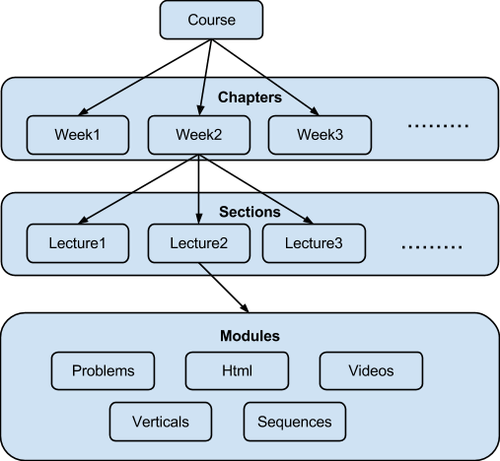
Course Structure (Diagram)

Slide 12
Activities
Designed template for MOOC website
Successfully installed edX-platform on local machine and server.
Modified edX platform to be run by ssh remotely
Tested edX platform by adding courses and other components such as :
Codejail
Discussion forum
Mail service
Google Calendar

Slide 13
Challenges Faced
Resolved
Proxy in installation with setup script and discussion forum
Less than a month time challenge (code release: 1st June)
Version management and merge of commits from other contributors of edX-platform.
Modification of installation script for Ubuntu 12.04 and above

Slide 14
Challenges Faced
Unresolved
Unstable and alpha staged edX components.
Platform dependency on *nix(Unix like).

Slide 15
Project Take-Away
Python (a programming language)
Django framework(MVC framework)
MongoDB (NoSQL DBMS)
Sass (Simply Awesome Style-sheet)
Rake (software task management tool)
GIT (version control)

Slide 16
Future Plans
Video tagging – Self note taking whenever the need be.
Bookmarks.
Text highlighting in e-books and study materials.
Easy navigation in discussion forums.
Advanced search filter

Slide 17
Demonstration

Slide 18

Queries

Slide 19
Thank you
-MOOC team

